Slide 1
OPEN
DATA
SCIENCE
CONFERENCE
#ODSC
Santa Clara | November 4-6th 2016
An Introduction to Causal Inference in Tech
Emily Glassberg Sands
emily@coursera.org, @emilygsands

Slide 2

About me
Harvard Economics PhD
Data Science Manager @ Coursera
econometrics
causal inference
experimental design
labor markets & education

Slide 3

Does X drive Y?
Did PR coverage drive sign-ups?
Does mobile app improve retention?
Does customer support increase sales?
Would lowering price increase revenues?
...
Inspired by work with Duncan Gilchrist, Economist and Data Scientist @ Wealthfront

Slide 4
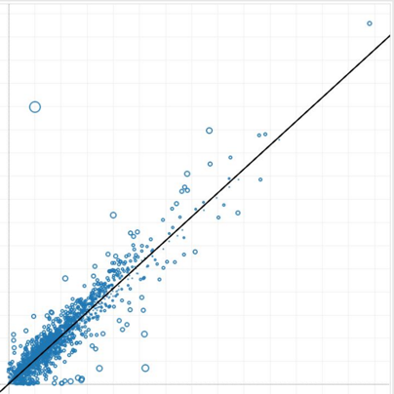

Does X drive Y?
Raw Correlation
Users engaging with X more likely to have outcome Y?
Plot Y against X
corr(X, Y)
But beware confounding variables

Slide 5

“Impact” of Mobile App Usage on Retention
Mobile Usage? | MoM Retention
No | 35%
Yes | 40%
Selection Bias?

Slide 6
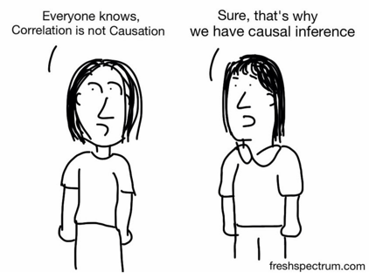

Slide 7
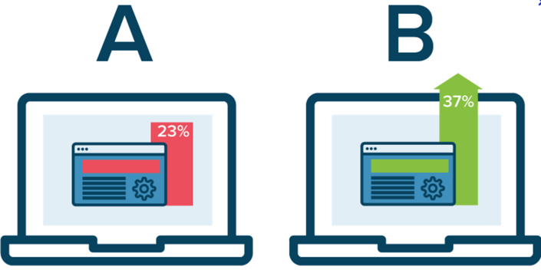
Does X drive Y?
Testing
Randomly assign some users and not others an experience
Estimate the causal effect of the experience on the outcome
Often best path forward… ...but not in all cases

Slide 8

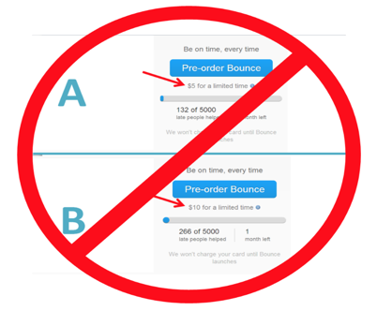
Limitations of A/B Testing
Consider user experience
Consider ethics
Consider effect on user trust

Slide 9

5 Econometric Methods for Causal Inference
Controlled Regression
Difference-in-Differences
Instrumental Variables
Regression Discontinuity Design
Fixed Effects Regression

Slide 10
Controlled Regression

Slide 11
Method 1: Controlled Regression
Method 1: Controlled Regression
Idea: Control directly for the confounding variables in a regression of Y on X
Assumption: Distribution of outcomes, Y, conditionally independent of treatment, X, given the confounders, C
Method 2: Regression Discontinuity Design
Method 3: Difference-in- Differences
Method 4: Fixed Effects Regression
Method 5: Instrumental Variables

Slide 12
Method 1: Controlled Regression
Method 1: Controlled Regression
Example: Effect of live chat support on sales.
Age confounder → Upward bias if regress sales on chat support
Add control for age
In R:
Method 2: Regression Discontinuity Design
Method 3: Difference-in- Differences
fit <- lm(Y ~ X + C, data = ...)
summary(fit)
Method 4: Fixed Effects Regression
Method 5: Instrumental Variables

Slide 13
Method 1: Controlled Regression
Method 1: Controlled Regression
Pitfall 1: “Missing” controls →
Omitted Variable Bias
Can we tell how much of a problem?
If adding proxies increases (adjusted) R-squared without impacting estimate, could be ok...*
*Oster 15 provides a formal treatment.
Method 2: Regression Discontinuity Design
Method 3: Difference-in- Differences
Method 4: Fixed Effects Regression
Method 5: Instrumental Variables

Slide 14
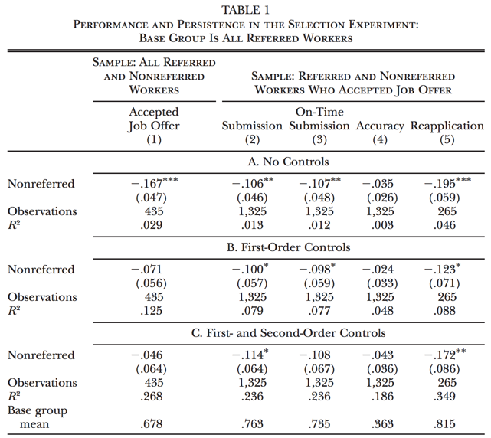
Adding controls does NOT change point estimate

Slide 15
Method 1: Controlled Regression
Method 1: Controlled Regression
...but if adding proxies to regression impacts coefficient on X, regression won’t suffice.
Adding controls DOES change point estimate
Method 2: Regression Discontinuity Design
Relationship between Instructor & Enrollee Gender
 | Share Enrollments F
Any Instructor F | .090*** | .035***
 | (0.0076) | (0.0074)
Controls | NO | YES
Adjusted R-squared | 0.07 | 0.74
Base Group Mean | 0.32 | 0.32
Method 3: Difference-in- Differences
Method 4: Fixed Effects Regression
Method 5: Instrumental Variables

Slide 16

Watch for omitted variables biasing coefficient of interest

Slide 17
Method 1: Controlled Regression
Method 1: Controlled Regression
Pitfall 2: “Bad” controls →
Included Variable Bias
Example:
Suppose “ interest in product” is confounder
Control for proportion of emails opened?
Not if directly impacted by treatment!
Method 2: Regression Discontinuity Design
Method 3: Difference-in- Differences
Method 4: Fixed Effects Regression
Method 5: Instrumental Variables

Slide 18
Leave out “controls” that are themselves not fixed at the time treatment was determined

Slide 19
Regression Discontinuity Design

Slide 20
Method 2: Regression Discontinuity Design
Method 1: Controlled Regression
Idea: Focus on a cut-off point that can be thought of as a local randomized experiment
Example: Effect of passing course on income?
A/B test? Randomly passing some, failing others unethical
Controlled regression? Key unobservables like ability and motivation
Method 2: Regression Discontinuity Design
Method 3: Difference-in- Differences
Method 4: Fixed Effects Regression
Method 5: Instrumental Variables

Slide 21
Method 2: Regression Discontinuity Design
Method 1: Controlled Regression
Example cont’d: Passing cutoff → natural experiment!!
User earning 69 similar to user earning 70
Use discontinuity to estimate causal effect
In R:
Method 2: Regression Discontinuity Design
Method 3: Difference-in- Differences
library(rdd)
RDestimate(Y ~ D, data = …,
subset = …, cutpoint = …)
Method 4: Fixed Effects Regression
Method 5: Instrumental Variables

Slide 22
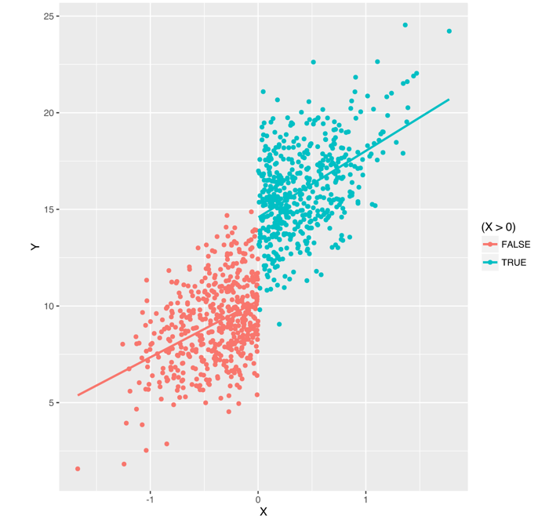
Method 2: Regression Discontinuity Design
Method 1: Controlled Regression
Method 2: Regression Discontinuity Design
Method 3: Difference-in- Differences
Method 4: Fixed Effects Regression
Method 5: Instrumental Variables
Threshold

Slide 23


Note on Validity - A/B testing
Type | Definition | Assumptions
Internal validity | Unbiased for subpopulation studied | Randomized correctly, i.e. samples balanced
External validity | Unbiased for full population | Experimental group representative of overall

Slide 24
Note on Validity - Regression Discontinuity Design
Type | Definition | Assumptions
Internal validity | Unbiased for subpopulation studied | Imprecise control of assignment No confounding discontinuities
External validity | Unbiased for full population | Homogeneous treatment effects

Slide 25
Method 2: Internal Validity in RDD
Method 1: Controlled Regression
Assumption 1: Imprecise control of assignment, AKA no manipulation at the threshold
Users cannot control whether just above versus just below the cutoff
In example: Cannot control grade around the cutoff (e.g., asking for re-grade).
How can we tell?
Method 2: Regression Discontinuity Design
Method 3: Difference-in- Differences
Method 4: Fixed Effects Regression
Method 5: Instrumental Variables

Slide 26
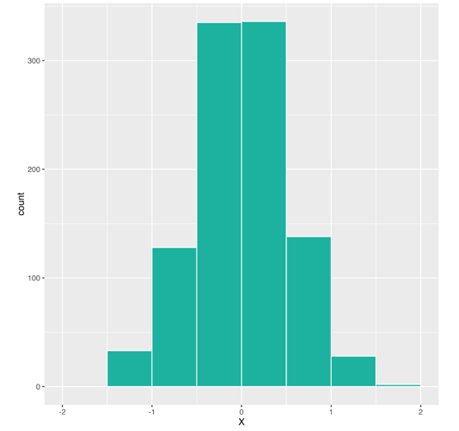
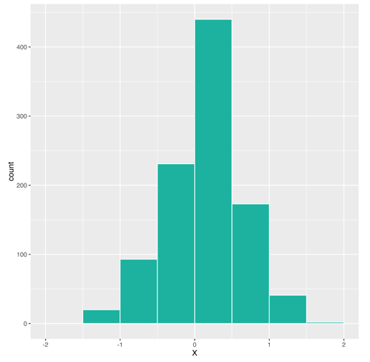
Method 2: Internal Validity in RDD
Method 1: Controlled Regression
Check 1: Mass just below ~= Mass just above
Method 2: Regression Discontinuity Design
Even mass around cut-off
Agency over assignment
Method 3: Difference-in- Differences
Method 4: Fixed Effects Regression
Method 5: Instrumental Variables

Slide 27
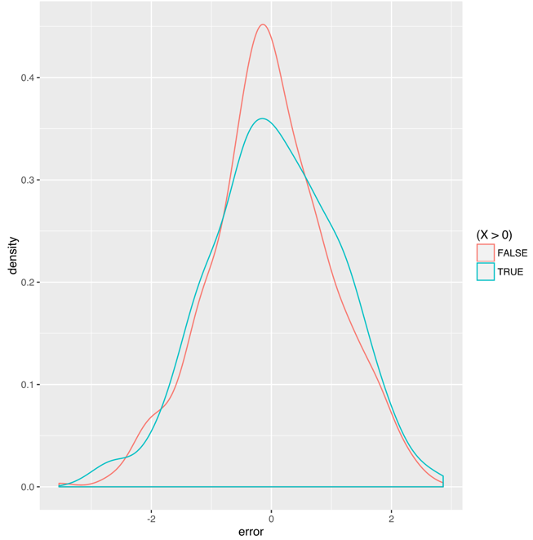
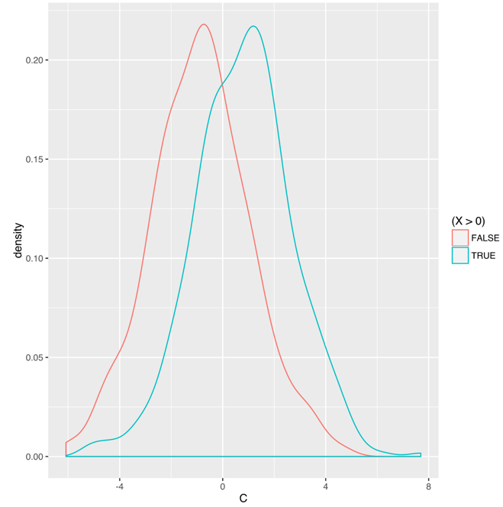
Method 2: Internal Validity in RDD
Method 1: Controlled Regression
Check 2: Composition of users in two buckets similar along key observable dimension(s)
Method 2: Regression Discontinuity Design
Similar on observable
Different on observable
Method 3: Difference-in- Differences
Method 4: Fixed Effects Regression
Method 5: Instrumental Variables

Slide 28
Check for manipulation at the threshold
Mass just below ~= Mass just above?
Just below vs. just above similar on key observables?

Slide 29
Method 2: Internal Validity in RDD
Method 1: Controlled Regression
Assumption 2: No confounding discontinuities
Being just above (versus just below) the cutoff should not influence other features
In example: Assumes passing is the only differentiator between a 60 and a 70
Method 2: Regression Discontinuity Design
Method 3: Difference-in- Differences
Method 4: Fixed Effects Regression
Method 5: Instrumental Variables

Slide 30
Watch out for confounding discontinuities

Slide 31
Note on Validity - Regression Discontinuity Design
Type | Definition | Assumptions
Internal validity | Unbiased for subpopulation studied | Imprecise control of assignment No confounding discontinuities
External validity | Unbiased for full population | Homogeneous treatment effects

Slide 32
Method 2: External Validity in RDD
Method 1: Controlled Regression
LATE: RDD estimates Local Average Treatment Effect (LATE)
“Local” around the cut-off
If heterogeneous treatment effects may not be applicable to the full group.
But interventions we’d consider would often occur on margin anyway
Method 2: Regression Discontinuity Design
Method 3: Difference-in- Differences
Method 4: Fixed Effects Regression
Method 5: Instrumental Variables

Slide 33
Estimated effect is “local” average treatment effect around cut-off

Slide 34
Difference-in-Differences

Slide 35
Method 3: Difference-in-Differences
Method 1: Controlled Regression
Idea: Comparison of pre and post outcomes between treatment and control groups
Example: Effect of lowering price on revenue?
A/B test? Could, but may be perceived as unfair
Alternative: Quasi-experimental design + DD
Method 2: Regression Discontinuity Design
Method 3: Difference-in- Differences
Method 4: Fixed Effects Regression
Method 5: Instrumental Variables

Slide 36
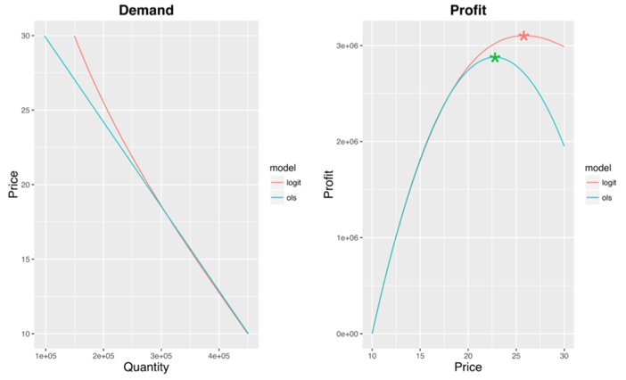

Slide 37
Method 3: Difference-in-Differences
Method 1: Controlled Regression
Idea: Comparison of pre and post outcomes between treatment and control groups
Example: Effect of lowering price on revenue?
A/B test? Could, but may be perceived as unfair
Alternative: Quasi-experimental design + DD
Method 2: Regression Discontinuity Design
Method 3: Difference-in- Differences
Method 4: Fixed Effects Regression
Method 5: Instrumental Variables

Slide 38
Method 3: Difference-in-Differences
Method 1: Controlled Regression
Example con’t:
Change price + RDD? But if co-timed marketing, feature launch, external shock …counterfactual no longer obvious...
Method 2: Regression Discontinuity Design
Method 3: Difference-in- Differences
Method 4: Fixed Effects Regression
Method 5: Instrumental Variables

Slide 39
Method 3: Difference-in-Differences
Method 1: Controlled Regression
Example con’t:
DD design. Change price in some geos (e.g., countries) but not others
Use control markets to compute counterfactual in treatment markets
Method 2: Regression Discontinuity Design
Method 3: Difference-in- Differences
Method 4: Fixed Effects Regression
Method 5: Instrumental Variables

Slide 40
DD more robust than RDD so design for DD where feasible

Slide 41
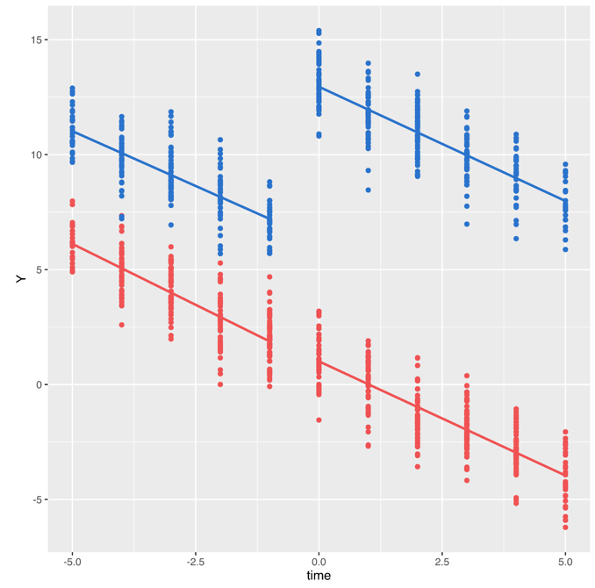
Method 3: Difference-in-Differences
Method 1: Controlled Regression
Treatment markets
Method 2: Regression Discontinuity Design
Method 3: Difference-in- Differences
Control markets
Method 4: Fixed Effects Regression
Method 5: Instrumental Variables
Date of Change

Slide 42
Method 3: Difference-in-Differences
Method 1: Controlled Regression
In R:
fit <- lm(Y ~ treatment +
post +
I(treatment * post),
data = … )
summary(fit)
Method 2: Regression Discontinuity Design
Method 3: Difference-in- Differences
Method 4: Fixed Effects Regression
Method 5: Instrumental Variables

Slide 43
Method 3: Difference-in-Differences
Method 1: Controlled Regression
In R (with time trends):
fit <- lm(Y ~ time +
treatment +
I((time >= 0) * treatment),
data = … )
summary(fit)
Method 2: Regression Discontinuity Design
Method 3: Difference-in- Differences
Method 4: Fixed Effects Regression
Method 5: Instrumental Variables

Slide 44
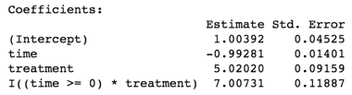
Method 3: Difference-in-Differences
Method 1: Controlled Regression
Method 2: Regression Discontinuity Design
Method 3: Difference-in- Differences
Method 4: Fixed Effects Regression
Method 5: Instrumental Variables

Slide 45
Method 3: Difference-in-Differences
Method 1: Controlled Regression
Treatment markets
Method 2: Regression Discontinuity Design
Method 3: Difference-in- Differences
Control markets
Method 4: Fixed Effects Regression
Method 5: Instrumental Variables
Date of Change

Slide 46
Note on Validity - Difference-in-Differences
Type | Definition | Assumptions
Internal validity | Unbiased for subpopulation studied | Parallel trends
External validity | Unbiased for full population | Homogeneous treatment effect

Slide 47
Method 3: Internal Validity in DD
Method 1: Controlled Regression
Assumption: Parallel trends
Absent treatment, same trends
In example: Treatment and control markets would have followed same trends if no price change
How can we tell?
Method 2: Regression Discontinuity Design
Method 3: Difference-in- Differences
Method 4: Fixed Effects Regression
Method 5: Instrumental Variables

Slide 48
Method 3: Internal Validity in DD
Method 1: Controlled Regression
Pre-experiment:
Make treatment and control similar
Stratified randomization.
Stratify based on key attributes
Randomize within strata
Pool across strata
Matched pairs. Historically followed similar trends and/or are expected to respond similarly to internal or external shocks
Method 2: Regression Discontinuity Design
Method 3: Difference-in- Differences
Method 4: Fixed Effects Regression
Method 5: Instrumental Variables

Slide 49
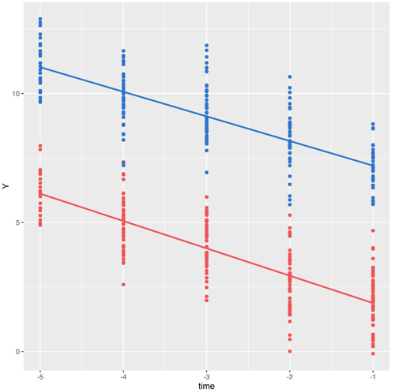
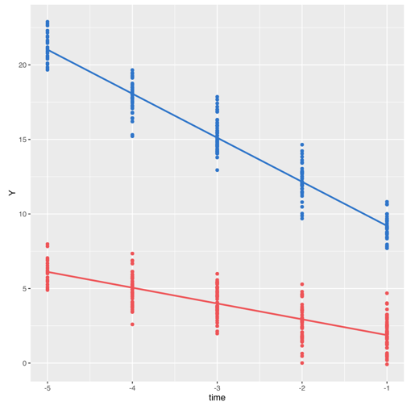
Method 3: Internal Validity in DD
Method 1: Controlled Regression
Pre-experiment (cont):
Check graphically & statistically that pre-experiment trends parallel
Method 2: Regression Discontinuity Design
Parallel trends
NOT parallel trends
Method 3: Difference-in- Differences
Method 4: Fixed Effects Regression
Method 5: Instrumental Variables

Slide 50
Design DD for parallel trends
Set-up: stratified randomization, matched pairs
Check: parallel trends ex ante

Slide 51
Method 3: Internal Validity in DD
Method 1: Controlled Regression
Post roll-out:
Problem 1: Confounder(s) in certain treatment or control market(s), e.g., launch localized payments
Solution 1: Exclude those observations.
Method 2: Regression Discontinuity Design
Method 3: Difference-in- Differences
Method 4: Fixed Effects Regression
Method 5: Instrumental Variables

Slide 52
Method 3: Internal Validity in DD
Method 1: Controlled Regression
Post roll-out (cont):
Problem 2: Confounder(s) in subset of treatment and control market(s), e.g., Euro value plunges
Solution 2: Difference-in-Difference-in-Difference
Method 2: Regression Discontinuity Design
Method 3: Difference-in- Differences
Method 4: Fixed Effects Regression
Method 5: Instrumental Variables

Slide 53
Consider excluding confounded observations, or triple differencing

Slide 54
Note on Validity - Difference-in-Differences
Type | Definition | Assumptions
Internal validity | Unbiased for subpopulation studied | Parallel trends
External validity | Unbiased for full population | Homogeneous treatment effect

Slide 55
Method 3: External Validity in DD
Method 1: Controlled Regression
Assumption: Homogeneous treatment effects, as with RDD
Pricing caveat: General Equilibrium? In experiment, users influenced by price change
Can cut on new users only
See Pricing Post for more pricing tips
Method 2: Regression Discontinuity Design
Method 3: Difference-in- Differences
Method 4: Fixed Effects Regression
Method 5: Instrumental Variables

Slide 56
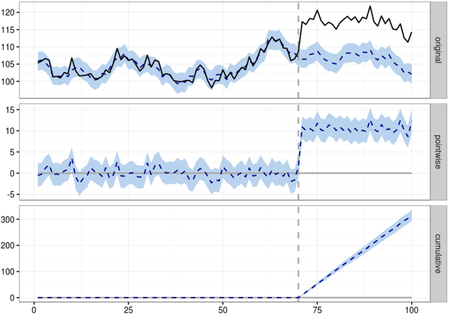
Method 3: Extension: Bayesian Approach
Method 1: Controlled Regression
Idea: Construct a Bayesian structural time-series model and use to predict counterfactual
Open source resource: Google’s CausalImpact
Method 2: Regression Discontinuity Design
Method 3: Difference-in- Differences
Method 4: Fixed Effects Regression
Method 5: Instrumental Variables

Slide 57
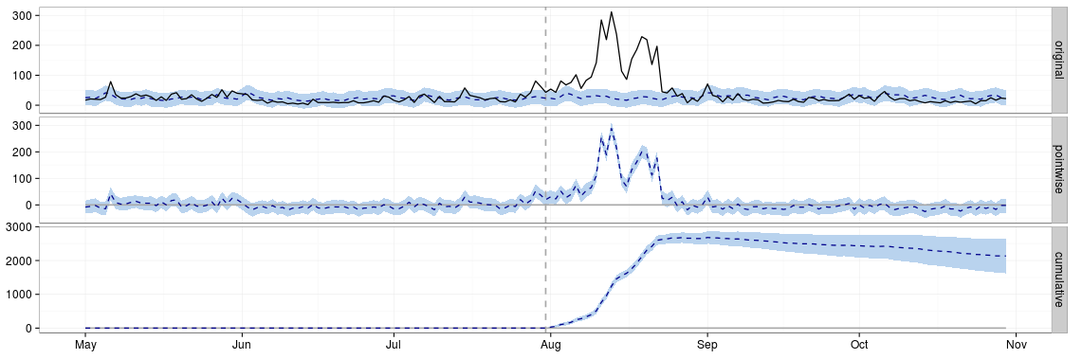
Method 3: Extension: Bayesian Approach
Method 1: Controlled Regression
Example: Discrete shock in given market, e.g.,
PR announcement in India
New partnership with Singaporean government
A/B testing infeasible; CausalImpact compares pre/post in treated/untreated markets
Method 2: Regression Discontinuity Design
Method 3: Difference-in- Differences
Method 4: Fixed Effects Regression
Method 5: Instrumental Variables

Slide 58
Fixed Effects Regression

Slide 59
Method 4: Fixed Effects Regression
Method 1: Controlled Regression
Idea: Special type of controlled regression
most commonly used with panel data
often to capture heterogeneity across individuals (or products) fixed over time
Example: Estimate effect of price on conversion
1(pay) = ɑ + β*1($49) + X’Ⲅ
X is vector of product fixed effects
Ⲅ is a vector of product-specific intercepts
Method 2: Regression Discontinuity Design
Method 3: Difference-in- Differences
Method 4: Fixed Effects Regression
Method 5: Instrumental Variables

Slide 60
Method 4: Fixed Effects Regression
Method 1: Controlled Regression
In R:
Note: Requires meaningful variation in X after controlling for fixed effects.
Method 2: Regression Discontinuity Design
fit <- lm(Y ~ X + factor(SKU), data = …)
summary(fit)
Method 3: Difference-in- Differences
Method 4: Fixed Effects Regression
Method 5: Instrumental Variables

Slide 61
Note on Validity - Fixed Effects
Type | Definition | Assumptions
Internal validity | Unbiased for subpopulation studied | Imprecise control of assignment No confounding discontinuities
External validity | Unbiased for full population | Homogeneous treatment effects

Slide 62
Instrumental Variables

Slide 63

Method 5:
Instrumental Variables
Method 1: Controlled Regression
Idea: “Instrument” for X of interest with some feature, Z, that drives Y only through its effect on X; back out effect of X on Y
Requirements:
Strong first stage: Z meaningfully affects X
Exclusion restriction: Z affects Y only through its effect on X
Method 2: Regression Discontinuity Design
Method 3: Difference-in- Differences
Method 4: Fixed Effects Regression
Method 5: Instrumental Variables

Slide 64
Method 5:
Instrumental Variables
Method 1: Controlled Regression
Implementation:
Instrument for X with Z
Estimate the effect of (instrumented) X on Y
In R:
Method 2: Regression Discontinuity Design
Method 3: Difference-in- Differences
library(aer)
fit <- ivreg(Y ~ X | Z, data = …)
summary(fit, vcov = sandwich,
df = Inf, diagnostics = TRUE)
Method 4: Fixed Effects Regression
Method 5: Instrumental Variables

Slide 65
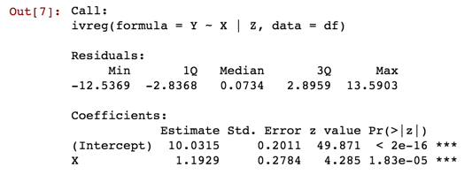
Method 5:
Instrumental Variables
Method 1: Controlled Regression
Sample output:
Method 2: Regression Discontinuity Design
Method 3: Difference-in- Differences
Method 4: Fixed Effects Regression
Method 5: Instrumental Variables

Slide 66
Method 5:
Instrumental Variables
Method 1: Controlled Regression
Instruments in real world? Often look to policies
Method 2: Regression Discontinuity Design
Y | X | Instrument | Economist(s)
Earnings | Education | Vietnam Draft lottery | Angrist
 |  | Compulsory schooling laws | Angrist & Krueger
 |  | Quarter of birth | Angrist & Krueger
Crime | Prison populations | Prison overcrowding litigation | Levitt
 | Police | Electoral cycles | Levitt
Method 3: Difference-in- Differences
Method 4: Fixed Effects Regression
Method 5: Instrumental Variables

Slide 67
Method 5:
Instrumental Variables
Method 1: Controlled Regression
Instruments in tech? Everywhere! Especially old A/B tests
Method 2: Regression Discontinuity Design
Method 3: Difference-in- Differences
Method 4: Fixed Effects Regression
Method 5: Instrumental Variables

Slide 68
Method 5:
Instrumental Variables
Method 1: Controlled Regression
Instruments in tech? Everywhere! Especially old A/B tests
Method 2: Regression Discontinuity Design
Y | X | Instrument | Data Scientist
Platform retention | Having friends on the platform | Referral test 1 | You!
 |  | Referral test 2 | You!
 |  | Referral test 3 | You!
 |  | ... | ...
Method 3: Difference-in- Differences
Method 4: Fixed Effects Regression
Method 5: Instrumental Variables

Slide 69
Note on Validity - Instrumental Variables
Type | Definition | Assumptions
Internal validity | Unbiased for subpopulation studied | Strong first stage Exclusion restriction
External validity | Unbiased for full population | Homogeneous treatment effect

Slide 70

Method 5:
Internal Validity in IV
Method 1: Controlled Regression
Assumption 1: Strong first stage
Experiment we chose “successful” at driving X
Why matters: If Z not strong predictor of X, second stage estimate will be biased.
How can we tell? Check F-statistic on the first stage regression; should be > 11 (rule-of-thumb)
`Diagnostics = TRUE’ in R will include test of weak instruments
Method 2: Regression Discontinuity Design
Method 3: Difference-in- Differences
Method 4: Fixed Effects Regression
Method 5: Instrumental Variables

Slide 71
Method 5:
Internal Validity in IV
Method 1: Controlled Regression
Assumption 2: Exclusion restriction
Z affects Y only through X
How can we tell? No test; have to go on logic
In the example:
Control group got otherwise equivalent email
Control group got no email
Method 2: Regression Discontinuity Design
Method 3: Difference-in- Differences
Method 4: Fixed Effects Regression
Method 5: Instrumental Variables

Slide 72
Note on Validity - Instrumental Variables
Type | Definition | Assumptions
Internal validity | Unbiased for subpopulation studied | Strong first stage Exclusion restriction
External validity | Unbiased for full population | Homogeneous treatment effects

Slide 73
Method 5:
External Validity in IV
Method 1: Controlled Regression
LATE: RDD estimates Local Average Treatment Effect (LATE)
Relevant for the group impacted by the instrument
If heterogeneous treatment effects may not be applicable to the full group.
But interventions we’d consider would often occur on margin anyway
Method 2: Regression Discontinuity Design
Method 3: Difference-in- Differences
Method 4: Fixed Effects Regression
Method 5: Instrumental Variables

Slide 74
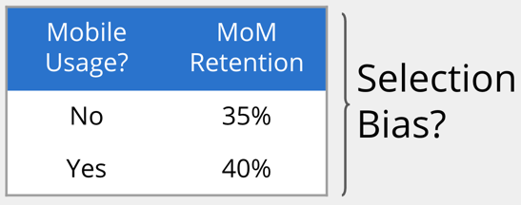

Method 5:
Make-Your-Own-Instrument!
Method 1: Controlled Regression
Method 2: Regression Discontinuity Design
Method 3: Difference-in- Differences
Instrumental variables via randomized encouragement
+
Method 4: Fixed Effects Regression
Method 5: Instrumental Variables
Notes:
In some cases, want to estimate the causal effects of X on Y but don’t have any good historical AB tests on hand to leverage IV methods. The good news is, AB tests can be implemented specifically to facilitate IV estimation! These AB tests even come with a sexy name — Randomized Encouragement Trials.
Returning to the example of mobile app usage on retention. We believe the raw relationships are biased by selection - more committed users being multi-device users. And we aren’t comfortable withholding the app from a bunch of users for all sorts of reasons. Here, we can push or not push the mobile app in, for example, emails or onsite, and use that treatment to to estimate the effect of app usage on retention. And voila - a randomized encouragement trial.

Slide 75
Extensions: ML + Causal Inference

Slide 76
Extensions & New Directions:
ML + Causal Inference
Traditionally distinct literatures:
Machine Learning focuses on prediction
Nonparametric prediction methods
Cross-validation for model selection
Economics and statistics focuses on causality
Weaknesses of classic causal approaches:
Fail with many covariates
Model selection unprincipled
ML + Causal Inference = <3

Slide 77

Extensions & New Directions:
ML + Causal Inference: LASSO
Idea: In cases where many possible instrument sets, use LASSO (penalized least squares) to select instruments
Benefits:
Less prone to data mining → more robust
Stronger first stage → less weak instrument bias

Slide 78
Extensions & New Directions:
ML + Causal Inference: LASSO
Example: Want to estimate social spillovers in movie consumption.
Causal effect of viewership on later viewership?
Instrument for viewership with weather

Slide 79
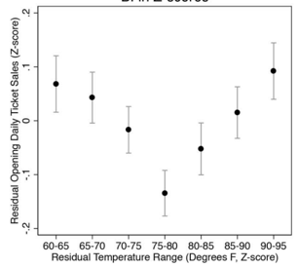
Extensions & New Directions:
ML + Causal Inference: LASSO
Effect of weather shocks on viewership

Slide 80
Extensions & New Directions:
ML + Causal Inference: LASSO
Example: Want to estimate social spillovers in movie consumption.
Causal effect of viewership on later viewership?
Instrument for viewership with weather
Challenge: Potential set of instruments large
Risk of overfitting (e.g., including all)
Risk of data minimum (e.g., hand-picking)
Solution: Implement LASSO methods to estimate optimal instruments in linear IV models with many instruments

Slide 81
Extensions & New Directions:
ML + Causal Inference: Trees
Idea: In cases where heterogeneous treatment effects, use trees to identify subgroups
Example: Want to identify a partition of the covariate space into subgroups based on treatment effect heterogeneity
Solution: Athey & Imbens’ (2015) Causal Trees
like regression trees but focuses on MSE of treatment effect
output is treatment effect & CI by subgroup

Slide 82
Extensions & New Directions:
ML + Causal Inference: Forest
Idea: Extension of trees; want personalized estimate of treatment effect
Solution: Wager & Athey (2015) Causal Forests
estimate is CATE (conditional average treatment effect)
predictions are asymptotically normal
predictions centered on the true effect

Slide 83



Home grown resources
Sample R code and simulation output available on GitHub
Detailed context and more examples available on Medium
References and reading list available here

Slide 84
Thanks!!
Any questions?
You can find me at @emilygsands & emily@coursera.org

